Slide 1
Cloud Computing 3
Maximilian Skowron

Slide 2
01
02
Inhalt
03
Usecase DevOps
Usecase Datalake
Usecase Paas

Slide 3
Usecase Devops
01
GitHub Webhooks + API Gateway + Lambda + SNS

Slide 4
Usecase DEVOPS

Slide 5
Usecase Datalake
02
API Gateway + Lambda + EFS

Slide 6
Usecase DATALAKE

Slide 7
Usecase PaaS
03
ECS + Fargate + Copilot

Slide 8
Usecase PAAS

Slide 9
UNDERSTANDING THE PROBLEM
MERCURY
Mercury is the closest planet to the Sun
VENUS
Venus is the second planet from the Sun
SATURN
It’s composed mostly of hydrogen and helium

Slide 10
MAIN COMPETITORS
 | JUPITER | NEPTUNE | SATURN
 | Yes | No | Yes
 | No | Yes | No
 | No | Yes | Yes

Slide 11
MATURITY MODEL
BASIC
BELOW AVERAGE
AVERAGE
ADVANCED
WORD CLASS
PROCUREMENT STRATEGY
OUR COMPANY
MAIN COMPETITOR
HUMAN RESOURCES
PROCUREMENT PROCESS
TECHNOLOGY
SUPPLIER RELATIONSHIP

Slide 12

OUR SOLUTIONS
VENUS
Venus is the second planet from the Sun
MERCURY
Mercury is the closest planet to the Sun

Slide 13
PEST ANALYSIS
POLITICAL
SOCIAL
Mercury
Mars
Saturn
Mercury
Mars
Saturn
ECONOMICAL
TECHNOLOGY
Venus
Neptune
Jupiter
Venus
Neptune
Jupiter

Slide 14
VALUE CHAIN ANALYSIS
MERCURY
VENUS
SUPPORT ACTIVITIES
JUPITER
MARS
PRIMARY
ACTIVITIES
NEPTUNE
SATURN

Slide 15
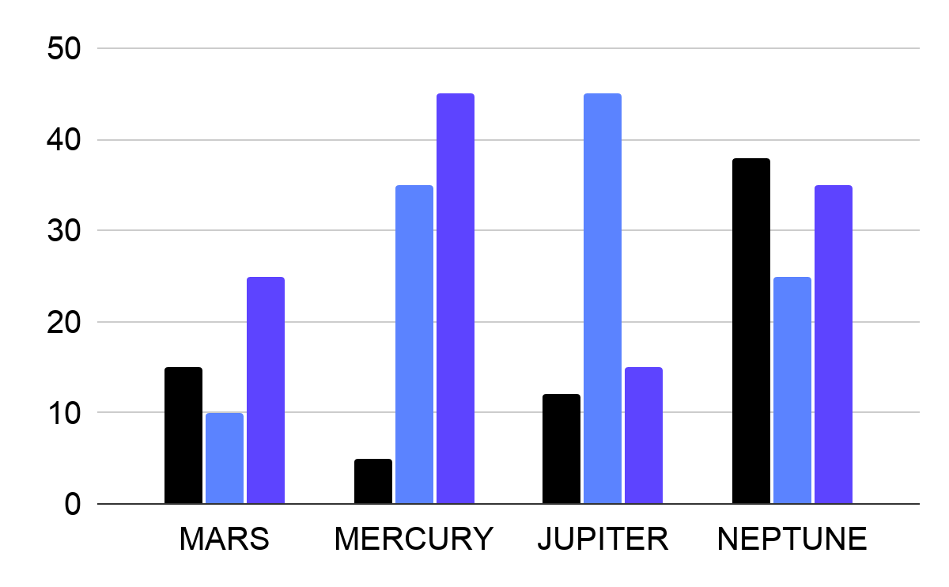
MARKET RESEARCH
MARS
MERCURY
Mercury is the smallest planet
JUPITER
Jupiter is the biggest planet
NEPTUNE
To modify this graph, click on it, follow the link, change the data and paste the new graph here
Neptune is the farthest planet

Slide 16
ANSOFF GROWTH MATRIX
Market Development Strategy
Diversification Strategy
CURRENT
PRODUCT
Market Penetration Strategy
Product Development Strategy
NEW
CURRENT
NEW
MARKET

Slide 17
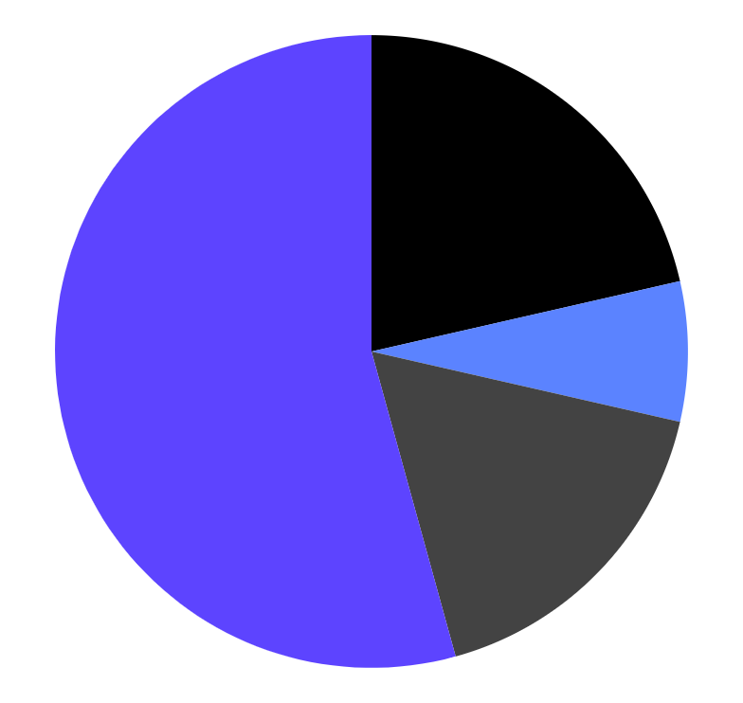
TARGET
$450
INTERESTS
Average Sale Per Customer
VENUS
20%
GENDER
MARS
53%
10%
NEPTUNE
60%
40%
17%
MERCURY
To modify this graph, click on it, follow the link, change the data and paste the new graph here

Slide 18
ANALYSIS
Mercury is a small planet
15,123
Mars is a very cold place
14,596
Saturn is the ringed one
36,548
Jupiter is the biggest planet
26,782

Slide 19
COMPETITOR COMPARISON
COMPANY NAME
30
COMPANY NAME
20
AVERAGE MARKET GROWTH
COMPANY GROWTH, %
COMPANY NAME
COMPANY NAME
10
0
0
10
20
30
40
MARKET SHARE, %

Slide 20
WHOA!
This could be the part of the presentation where you can have a little break and share an anecdote

Slide 21
“This is a quote, words full of wisdom that someone important said and can make the reader get inspired.”
—SOMEONE FAMOUS

Slide 22
UPCOMING GOALS
Do you know what helps you make your point clear? Lists like this one:
They’re simple
You can organize your ideas clearly
You’ll never forget to buy milk!
And the most important thing: the audience won’t miss the point of your presentation

Slide 23
BUSINESS ROADMAP
2018
2019
2020
Mercury
Mars
Jupiter
Neptune
Mercury
Mars
Jupiter
Neptune
Mercury
Mars
Jupiter
Neptune
PHASE 1
PHASE 2
PHASE 3

Slide 24

A PICTURE IS WORTH A THOUSAND WORDS

Slide 25
AWESOME WORDS

Slide 26
AWARDS
MERCURY
JUPITER
NEPTUNE
Mercury is the smallest planet
Jupiter is the biggest planet
Neptune is the farthest planet
MARS
VENUS
SATURN
Mars is a very cold place
Venus is the second planet
Saturn is the ringed one

Slide 27
OUR PARTNERS
MARS
SATURN
This planet is full of iron oxide dust
Saturn is the ringed one
MERCURY
VENUS
Mercury is the smallest one
Venus is the second planet

Slide 28
4,498,300
Big numbers catch your audience’s attention

Slide 29
333,000.00
OUR NUMBERS
24h 37m 23s
6,371 km
earths is the Sun’s mass
is Jupiter’s rotation period
is Earth’s radius

Slide 30
OUR PROCESS
01
STEP 1
This planet is full of iron oxide dust
02
STEP 2
Saturn is the ringed one
03
STEP 3
Mercury is the smallest one

Slide 31
OUR CONSULTANTS
HELENA JAMES
JOHN DAVIS
Here you can talk about this person
Here you can talk about this person
JENNA DOE
DAVID GREEN
Here you can talk about this person
Here you can talk about this person

Slide 32
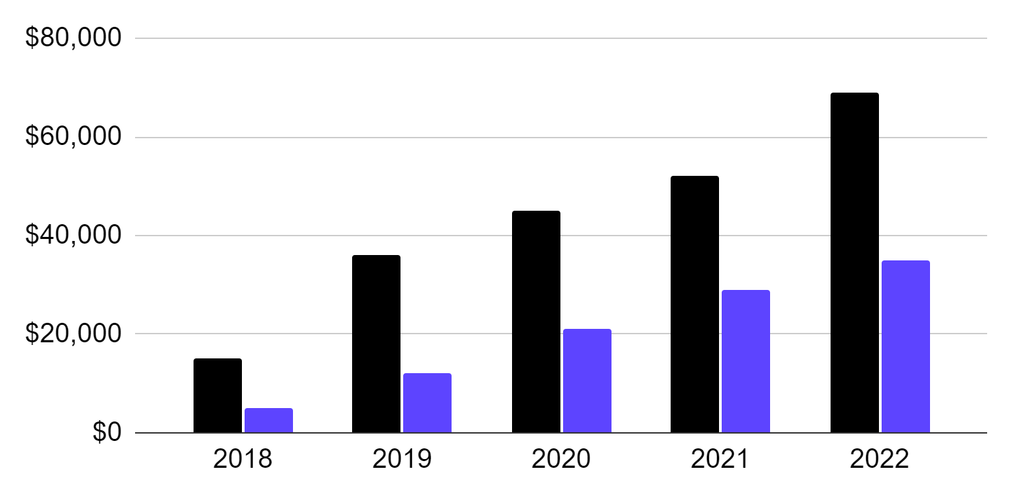
PROFIT AND LOSS FORECAST
MARS
SALES
NET PROFIT
To modify this graph, click on it, follow the link, change the data and paste the new graph here

Slide 33
SWOT ANALYSIS
STRENGTHS
S
W
WEAKNESSES
Strength 1
Strength 2
Strength 3
Weakness 1
Weakness 2
Weakness 3
OPPORTUNITIES
O
T
THREATS
Opportunity 1
Opportunity 2
Opportunity 3
Threat 1
Threat 2
Threat 3

Slide 34
RECOMMENDATIONS
 | MAY | JUN | JUL | AUG | SEP | OCT | NOV
Name of initiative 1
Name of initiative 2
Name of initiative 3
Name of initiative 4

Slide 35
PRICING MANAGEMENT PROJECT
# | Opportunities | Total of Business Opportunities | Low Margin | High Margin | Ease of Implementation
1 | Mars | $1020 | $500 | $700 | 10%
2 | Mercury | $4896 | $2400 | $3200 | 30%
3 | Jupiter | $2569 | $1200 | $1800 | 45%

Slide 36
TESTIMONIALS
JOHN GREEN
JENNA DOE
HELENA JAMES
“Mercury is the closest planet to the Sun and the smallest one”
“Venus has a beautiful name and is the second planet from the Sun”
“Jupiter is a gas giant and it is the biggest planet in the Solar System”

Slide 37
LEAN BUSINESS CASE
PROJECT COSTS
TANGIBLE BENEFITS
$4M
$14,896,236
NPV
CASH FLOW
$8M
7K
5K
3K
RESOURCES
-2K
156 items
-4K

Slide 38
LEAN BUSINESS CASE
INTANGIBLE BENEFITS
STRATEGIC ALIGNMENT
IMPACT
Mercury
Mars
Jupiter
Neptune
Mercury
Mars
Jupiter
Neptune
Low
High
PROJECT SPONSOR
PROJECT MANAGER
CHANGE
MANAGER
John Doe
Anna James
Jim Green

Slide 39
OPPORTUNITIES & SOLUTIONS
OPPORTUNITIES
SOLUTIONS
Mars
Neptune
Mercury
Venus
Jupiter
Saturn

Slide 40
DELIVERABLES & OUTCOMES
KEY
ACTIVITIES
KEY OUTCOMES
Mars
Mercury
Mars
Mercury
DELIVERABLES
OBJECTIVES
Mars
Mercury
Mars
Mercury

Slide 41
PROJECT COSTS
 | 2017 | 2018 | 2019 | 2020
COST ITEM 1 | 0.15 | 0.25 | 0.15 | 0.15
COST ITEM 2 | 0.25 | 0.35 | 0.35 | 0.25
COST ITEM 3 | 0.35 | 0.45 | 0.55 | 0.35

Slide 42
CHANGE IMPACT ASSESSMENT
Impact
Extreme
Low
High
Moderate
COMPLEXITY OF THE CHANGE
Medium
Medium
High
Moderate
Extreme
Low
1 team impacted
1 business unit
1 division
½ of the company
Extreme
SIZE OF THE CHANGE

Slide 43
RISK ASSESSMENT
RISK TITLE | PROBABILITY | IMPACT | MITIGATION
Mercury | Low | High | Mercury
Jupiter | High | Moderate | Jupiter
Mars | Low | Extreme | Mars

Slide 44
EXECUTIVE SUMMARY
PROBLEM & SOLUTION
MARKET ANALYSIS
MISSION & VISION
Mercury is the smallest planet
Jupiter is the biggest planet
Neptune is the farthest planet
COMPETITOR ANALYSIS
CUSTOMER SEGMENTS
MARKETING PLAN
Mars is a very cold place
Venus is the second planet
Saturn is the ringed one

Slide 45
MCKINSEY 7S
STRATEGY
STRUCTURE
SYSTEMS
HARD S
SHARED VALUES
SKILLS
STAFF
STYLE
SOFT S

Slide 46
MAIN BUSINESS PROBLEMS
PROFITABILITY
NEW PRODUCT
This planet is full of iron oxide dust
Saturn is the ringed one
NEW MARKET
M&A
Mercury is the smallest one
Venus is the second planet

Slide 47
BALANCED SCORECARD
PERSPECTIVE | STRATEGIC OBJECTIVES | KEY PERFORMANCE INDICATORS | TARGETS
FINANCIAL | Mercury is the smallest planet | Neptune is the farthest planet | Venus is the second planet
CUSTOMER | Jupiter is the biggest planet | Mars is actually a cold place | Saturn is a gas giant and has rings

Slide 48
SWEET SPOT
JUPITER
NEPTUNE
Jupiter is the biggest planet
Neptune is the farthest planet
MERCURY
SWEET SPOT
Mercury is the smallest planet

Slide 49
ORGANIZATIONAL CHART
CEO
Team 1
Team 2

Slide 50
MISSION AND VISION
MISSON
Despite being red, Mars is a
cold place. It’s full of iron oxide dust, which gives the planet its reddish cast
VISION
It’s a gas giant, the biggest planet in the Solar System and the fourth-brightest object in the sky

Slide 51
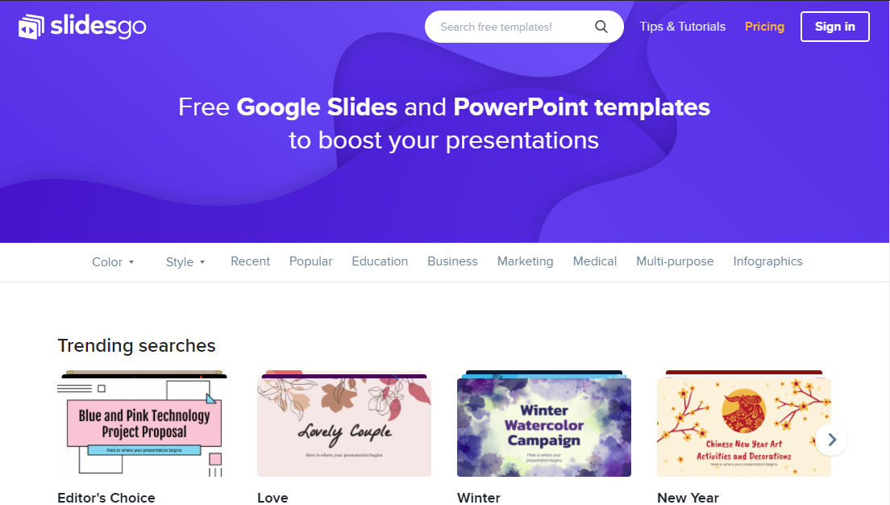
SNEAK PEEK
MERCURY
You can replace the image on the screen with your own work. Just delete this one, add yours and center it properly

Slide 52
THANKS!
Do you have any questions?
addyouremail@freepik.com +91 620 421 838 yourcompany.com
Please keep this slide for attribution

Slide 53
BUSINESS ICON PACK

Slide 54
ALTERNATIVE RESOURCES
PHOTOS
Business females working together
Man and woman working together for a new project
Business people teamwork
Corporate workers brainstorming together

Slide 55
RESOURCES
PHOTOS
High angle team meeting at office mock-up
People working on a project together
VECTORS
Flat design cms digital programs
ICONS
Business Icon Pack

Slide 56
Instructions for use
In order to use this template, you must credit Slidesgo by keeping the Thanks slide.
You are allowed to:
- Modify this template.
- Use it for both personal and commercial projects.
You are not allowed to:
- Sublicense, sell or rent any of Slidesgo Content (or a modified version of Slidesgo Content).
- Distribute Slidesgo Content unless it has been expressly authorized by Slidesgo.
- Include Slidesgo Content in an online or offline database or file.
- Offer Slidesgo templates (or modified versions of Slidesgo templates) for download.
- Acquire the copyright of Slidesgo Content.
For more information about editing slides, please read our FAQs or visit Slidesgo School:
https://slidesgo.com/faqs and https://slidesgo.com/slidesgo-school

Slide 57
Fonts & colors used
This presentation has been made using the following fonts:
Chakra Petch
(https://fonts.google.com/specimen/Chakra+Petch)
Roboto Slab
(https://fonts.google.com/specimen/Exo)
#321eb3
#5d44ff
#6c6df9
#8e9df7
#000000
#ffffff

Slide 58



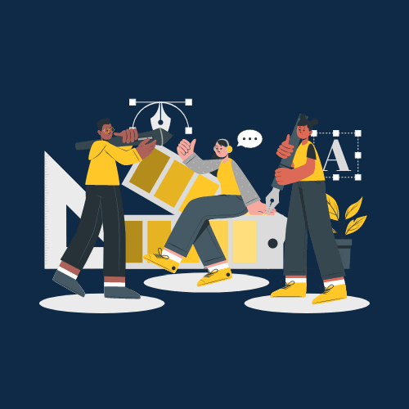

Storyset
Create your Story with our illustrated concepts. Choose the style you like the most, edit its colors, pick the background and layers you want to show and bring them to life with the animator panel! It will boost your presentation. Check out How it Works.
Pana
Amico
Bro
Rafiki
Cuate

Slide 59
Use our editable graphic resources...
You can easily resize these resources without losing quality. To change the color, just ungroup the resource and click on the object you want to change. Then, click on the paint bucket and select the color you want. Group the resource again when you’re done. You can also look for more infographics on Slidesgo.

Slide 62
JANUARY
FEBRUARY
MARCH
APRIL
MAY
JUNE
PHASE 1
Task 1
Task 2
PHASE 2
Task 1
Task 2
JANUARY
FEBRUARY
MARCH
APRIL
PHASE 1
Task 1
Task 2

Slide 65
...and our sets of editable icons
You can resize these icons without losing quality.
You can change the stroke and fill color; just select the icon and click on the paint bucket/pen.
In Google Slides, you can also use Flaticon’s extension, allowing you to customize and add even more icons.

Slide 66
Educational Icons
Medical Icons

Slide 67
Business Icons
Teamwork Icons

Slide 68
Help & Support Icons
Avatar Icons

Slide 69
Creative Process Icons
Performing Arts Icons

Slide 70
Nature Icons

Slide 71
SEO & Marketing Icons

Slide 72


